Slide 1
JOP 4 - Operations Brief 10/13/2022 08:00

Slide 2
Ground Rules
*7 to unmute/*6 mute
Telephone Hold Function
SEOC Desk Microphone

Slide 3
Incident Objectives
# | Objectives
1a | Conduct operations to maximize the protection of public health and welfare while ensuring the safety and security of responders.
4a | Conduct Mass Care operations in the affected area with a priority on life-sustaining work for survivors to include support for residential shelter-in-place emergency repairs and subsistence food replacement.
6a | Implement State and Federal Individual Assistance and Public Assistance programs in the declared area.
5a | Provide unified, clear, accurate, and inclusive information to the public and stakeholders.

Slide 4
IC Opening Remarks

Slide 5
Situation Brief
Notes:
Format for community reports to First Class conference should have as the subject line: Community – subject – time. Example: Stebbins – home damage – 15:00 hrs

Slide 6
Statewide Lifeline Status
Effected Area Lifeline Status

Slide 7
State of Alaska Assistance & Assessments
**Data current as of 0715 AKDT 10/13/2022**
Individual Assistance (IA) Applications.
Hotline applications | 56
Web applicants | 201
In-Person Applications | 180+
**Data current as of 1200 AKDT 10/12/2022**
Mass Care Housing Assessments Aggregated from Red Cross, Community report, AKOM observations, and Non-Profit reports.
Branch | Inspected | Destroyed | Major | Minor | Affected | Total impacted
I | ~125 | 6 | 109 | 0 | 0 | 115
II | ~93 | 11 | 38 | 11 | 16 | 76

Slide 8
FEMA Individual Assistance
**Data current as of 0810 AKDT 10/12/2022**
IA Daily Snapshot.
Total registrations | 486
Daily Registrations | 46
IHP $ Approved | $2,166,538.31
HA $ Approved | $752,229.79
ONA $ Approved | $1,414,308.52
IHP $ Disbursed | $2,099,935.86
HA $ Disbursed | $740,390.78
ONA $ Disbursed | $1,359545.08

Slide 9
Food, Water & Shelter
 | Food | Water | Shelter
Branch I | Mass Care Group confirmed the delivery to Chevak and Hooper Bay of 10k lbs. of fish from Trident Foods (Kodiak) and the donation of 6 pallets of subsistence food from CCTHIT. | Nothing Significant to Report | Hooper Bay: 21 sheltered at community run shelters overnight.
Branch II | Nothing Significant to Report | Golovin: Cleared by DEC to resume water production. | Golovin: 20 people were sheltered overnight. Crews continue to build gravel pads and raise houses. One home was demolished, was not structurally sound.
Branch III | Nothing Significant to Report | Utqiagvik: Saltwater lagoon is threatening the freshwater lagoon. Pt. Lay: Sewer plant bldg. damaged (roof and air ducts). Wainwright: Concerns about sewer lines to the pump station. | Utqiagvik: 2 homes, 1 apt building damaged. Kivalina: 3 homes, 1 commercial building damaged. Kotzebue: 3 homes damaged. Pt Hope: 3 homes damaged. Pt Lay: 1 home damaged. Wainwright: 1 home damaged. Wales: School reported roof damage.

Slide 10
Transportation
Roadways | Roadways
Branch II | Golovin: Heaters are in use under houses to aid in drying the underside. A house was moved and raised 2.5 ft. Nome: Major heavy construction is making good progress out the highway beyond the Breach and at end of shift drove a ‘silver spike’ at Mile 25.8. The ‘pioneer’ fill will now advance through the next stretch of the Site#6 damage corridor, from ~MP25.8 thru Solomon at ~35.4, along original highway alignment. Shaktoolik: Tumet began a borrow haul from the pit on the west side of town to the protection berm. Some sand removal is still occurring between and under homes. Night shift work will begin when equipment arrives.
Branch III | Utqiagvik: The bridge on Stevenson Road sustained damage but has reopened. Significant erosion to the access road with ¼ mile to be repaired and culvert that drains the outer salt lagoon damaged. Significant damage to protective berms and barriers exist with protective measures and repairs ongoing.

Slide 11
Transportation
Maritime | Roadways
Branch I | Saint George: Report of damage and erosion to the arms of the harbor.

Slide 12
HazMat
Facilities | Facilities
Branch II | Golovin: The 100’ of oil containment boom has been received. DEC will replace the spill response Conex in 2023. Stebbins: DEC will replace spill response Conex in 2023.
Branch III | Wainwright: Fuel lines to the school are exposed.

Slide 13
Weather Summary for SEOC Ops Brief
Low ceilings and fog will persist from Bethel north to Emmonak and Nunam Iqua through early afternoon.
Clearing out after 1 PM
No significant flying weather concerns across the Seward Peninsula and Norton Sound.
Elsewhere, heavy rain is occurring along the Gulf of AK coast. Flood watches in effect through Friday evening.
Nome: Sunrise today: 9:47 AM Sunset tonight: 7:46 PM
Bethel: Sunrise today: 9:24 AM Sunset tonight: 7:41 PM
Notes:
Replace Text with today’s key points. Stick to one slide unless there is really impactful weather. Never use more than two text slides. The key is to be brief and boil it all down to the key things the SEOC needs to know. Focus on the “what” and not the “why”.
https://www.timeanddate.com/sun/usa/nome
https://www.timeanddate.com/sun/usa/bethel

Slide 14
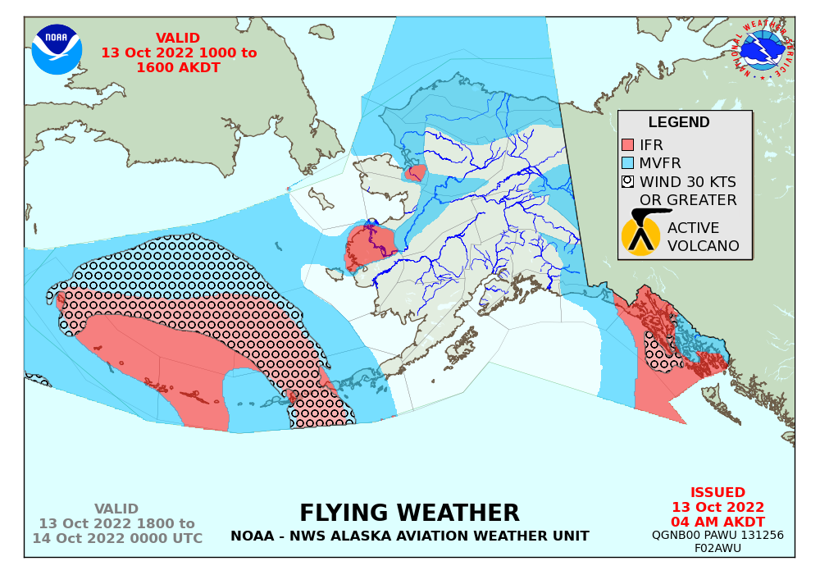
Today’s Flying Weather
Fog over much of the Y-K Delta will persist through 1 PM.
No concerns for Seward Peninsula.
Intermittent snow showers and ceilings ~ 2,000 FT over Branch 3.
Notes:
https://www.weather.gov/images/aawu/fcstgraphics/ifr_2.png

Slide 15
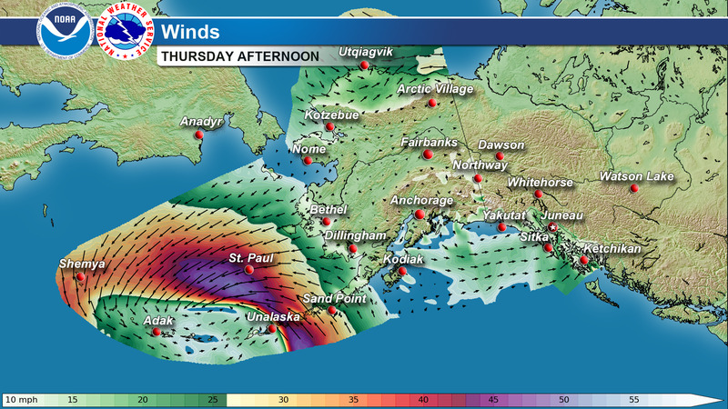
Today’s Wind Forecast
Notes:
https://www.weather.gov/images/afc/tv/misc/Winds_Tomorrow_Afternoon_state.jpg

Slide 16
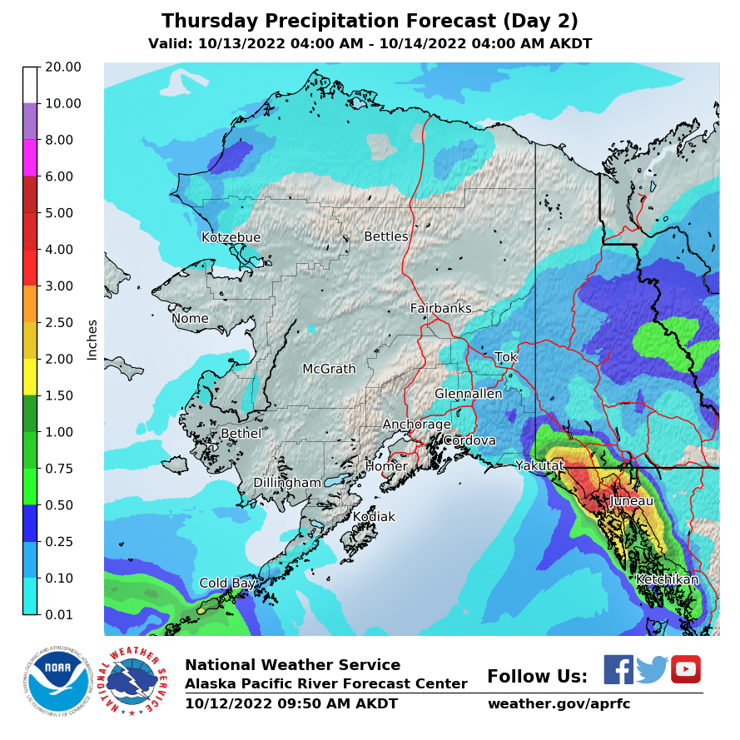
Today’s Precipitation
No significant precipitation along the West Coast.
Flood Watch in effect for Southeast Alaska through Friday night
Notes:
https://www.weather.gov/images/aprfc/qpf-qpe-maps/has_qpf48.png?t=1663791994317

Slide 17
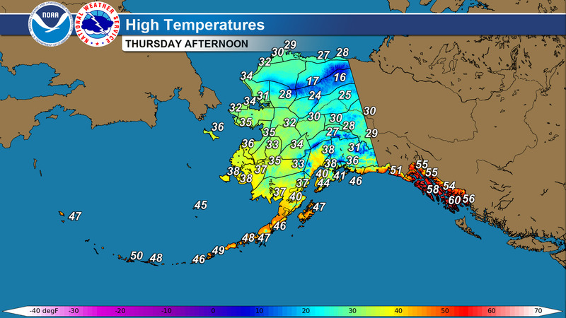
Today’s High Temp Forecast
Notes:
https://www.weather.gov/images/afc/tv/misc/Highs_Tomorrow.jpg

Slide 18
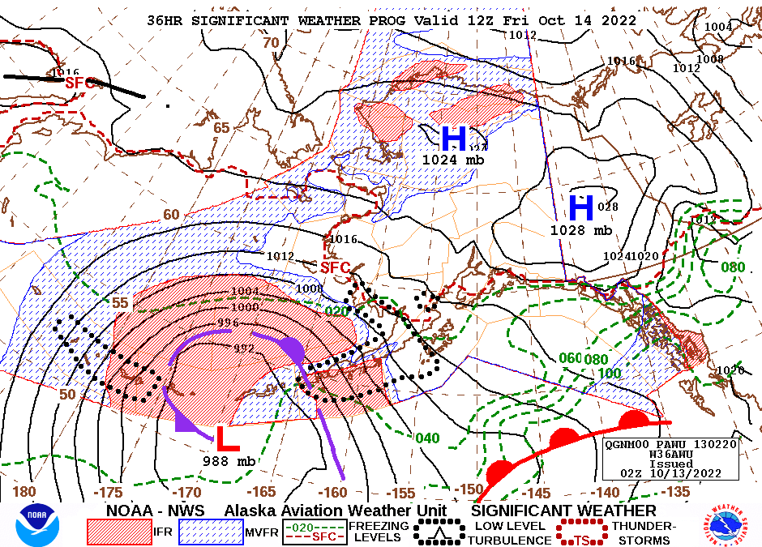
Tomorrow’s Flying Weather
No significant flying weather concerns on Friday for Branches 1 and 2.
Snow showers and occasional lower ceilings over Branch 3.
Notes:
https://www.weather.gov/images/aawu/sigWx36.gif

Slide 19
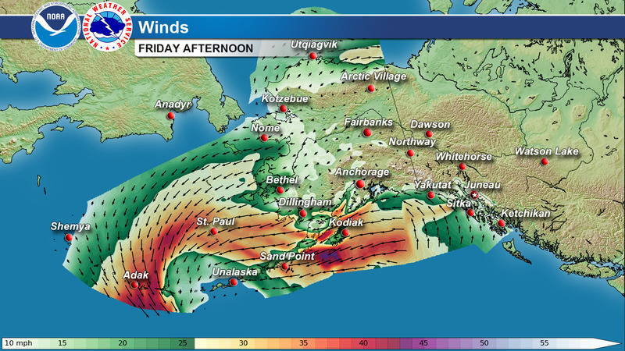
Tomorrow’s Wind Forecast
Notes:
https://www.weather.gov/images/afc/tv/misc/Winds_NextDay_Afternoon_state.jpg

Slide 20
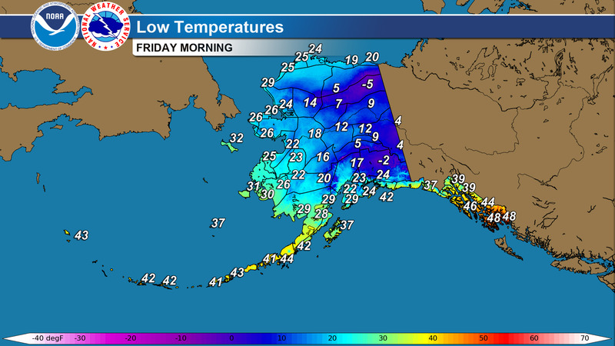
Tomorrow’s Low Temp Forecast
Notes:
https://www.weather.gov/images/afc/tv/misc/tv/Lows_Tomorrow_Night.jpg

Slide 21
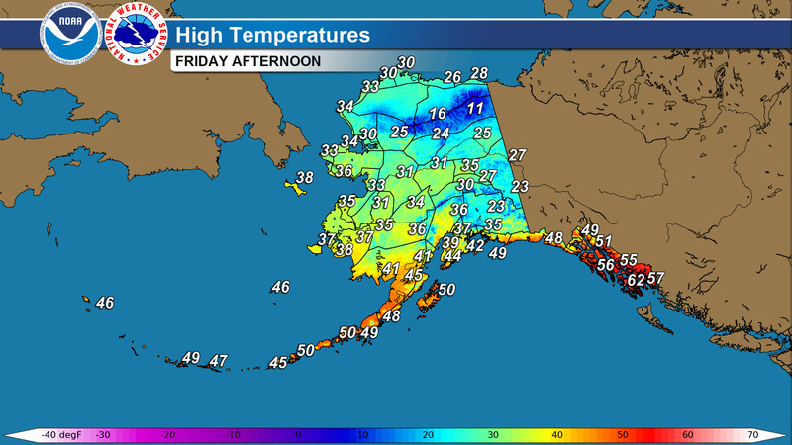
Tomorrow’s High Temp Forecast
Notes:
https://www.weather.gov/images/afc/tv/misc/Highs_NextDay.jpg

Slide 22
Anchorage 5-day Forecast
Notes:
Include Anchorage forecast and on brief on any hazards, esp. freezing temps and/or precip in Anchorage and the MatSu.
https://forecast.weather.gov/MapClick.php?lon=-149.838&lat=61.215#.Y0HGyHbMKUl

Slide 23
Operations

Slide 24
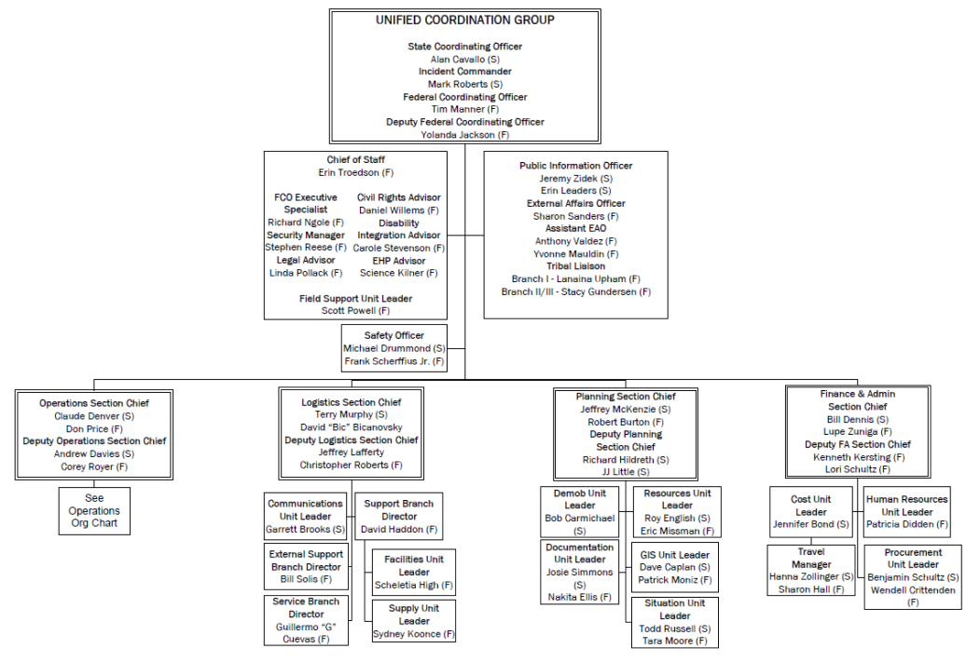
Command Task Organization

Slide 25
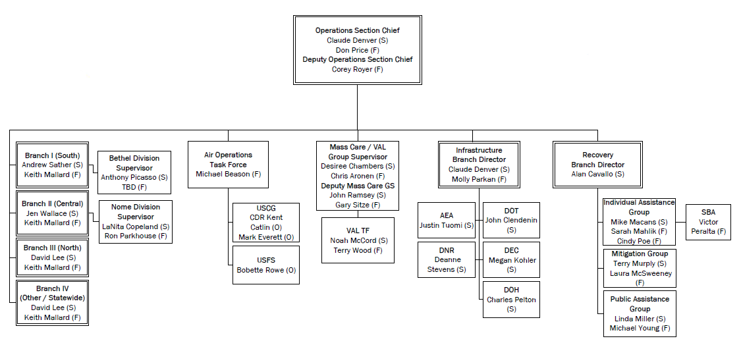
Operations Task Organization

Slide 26
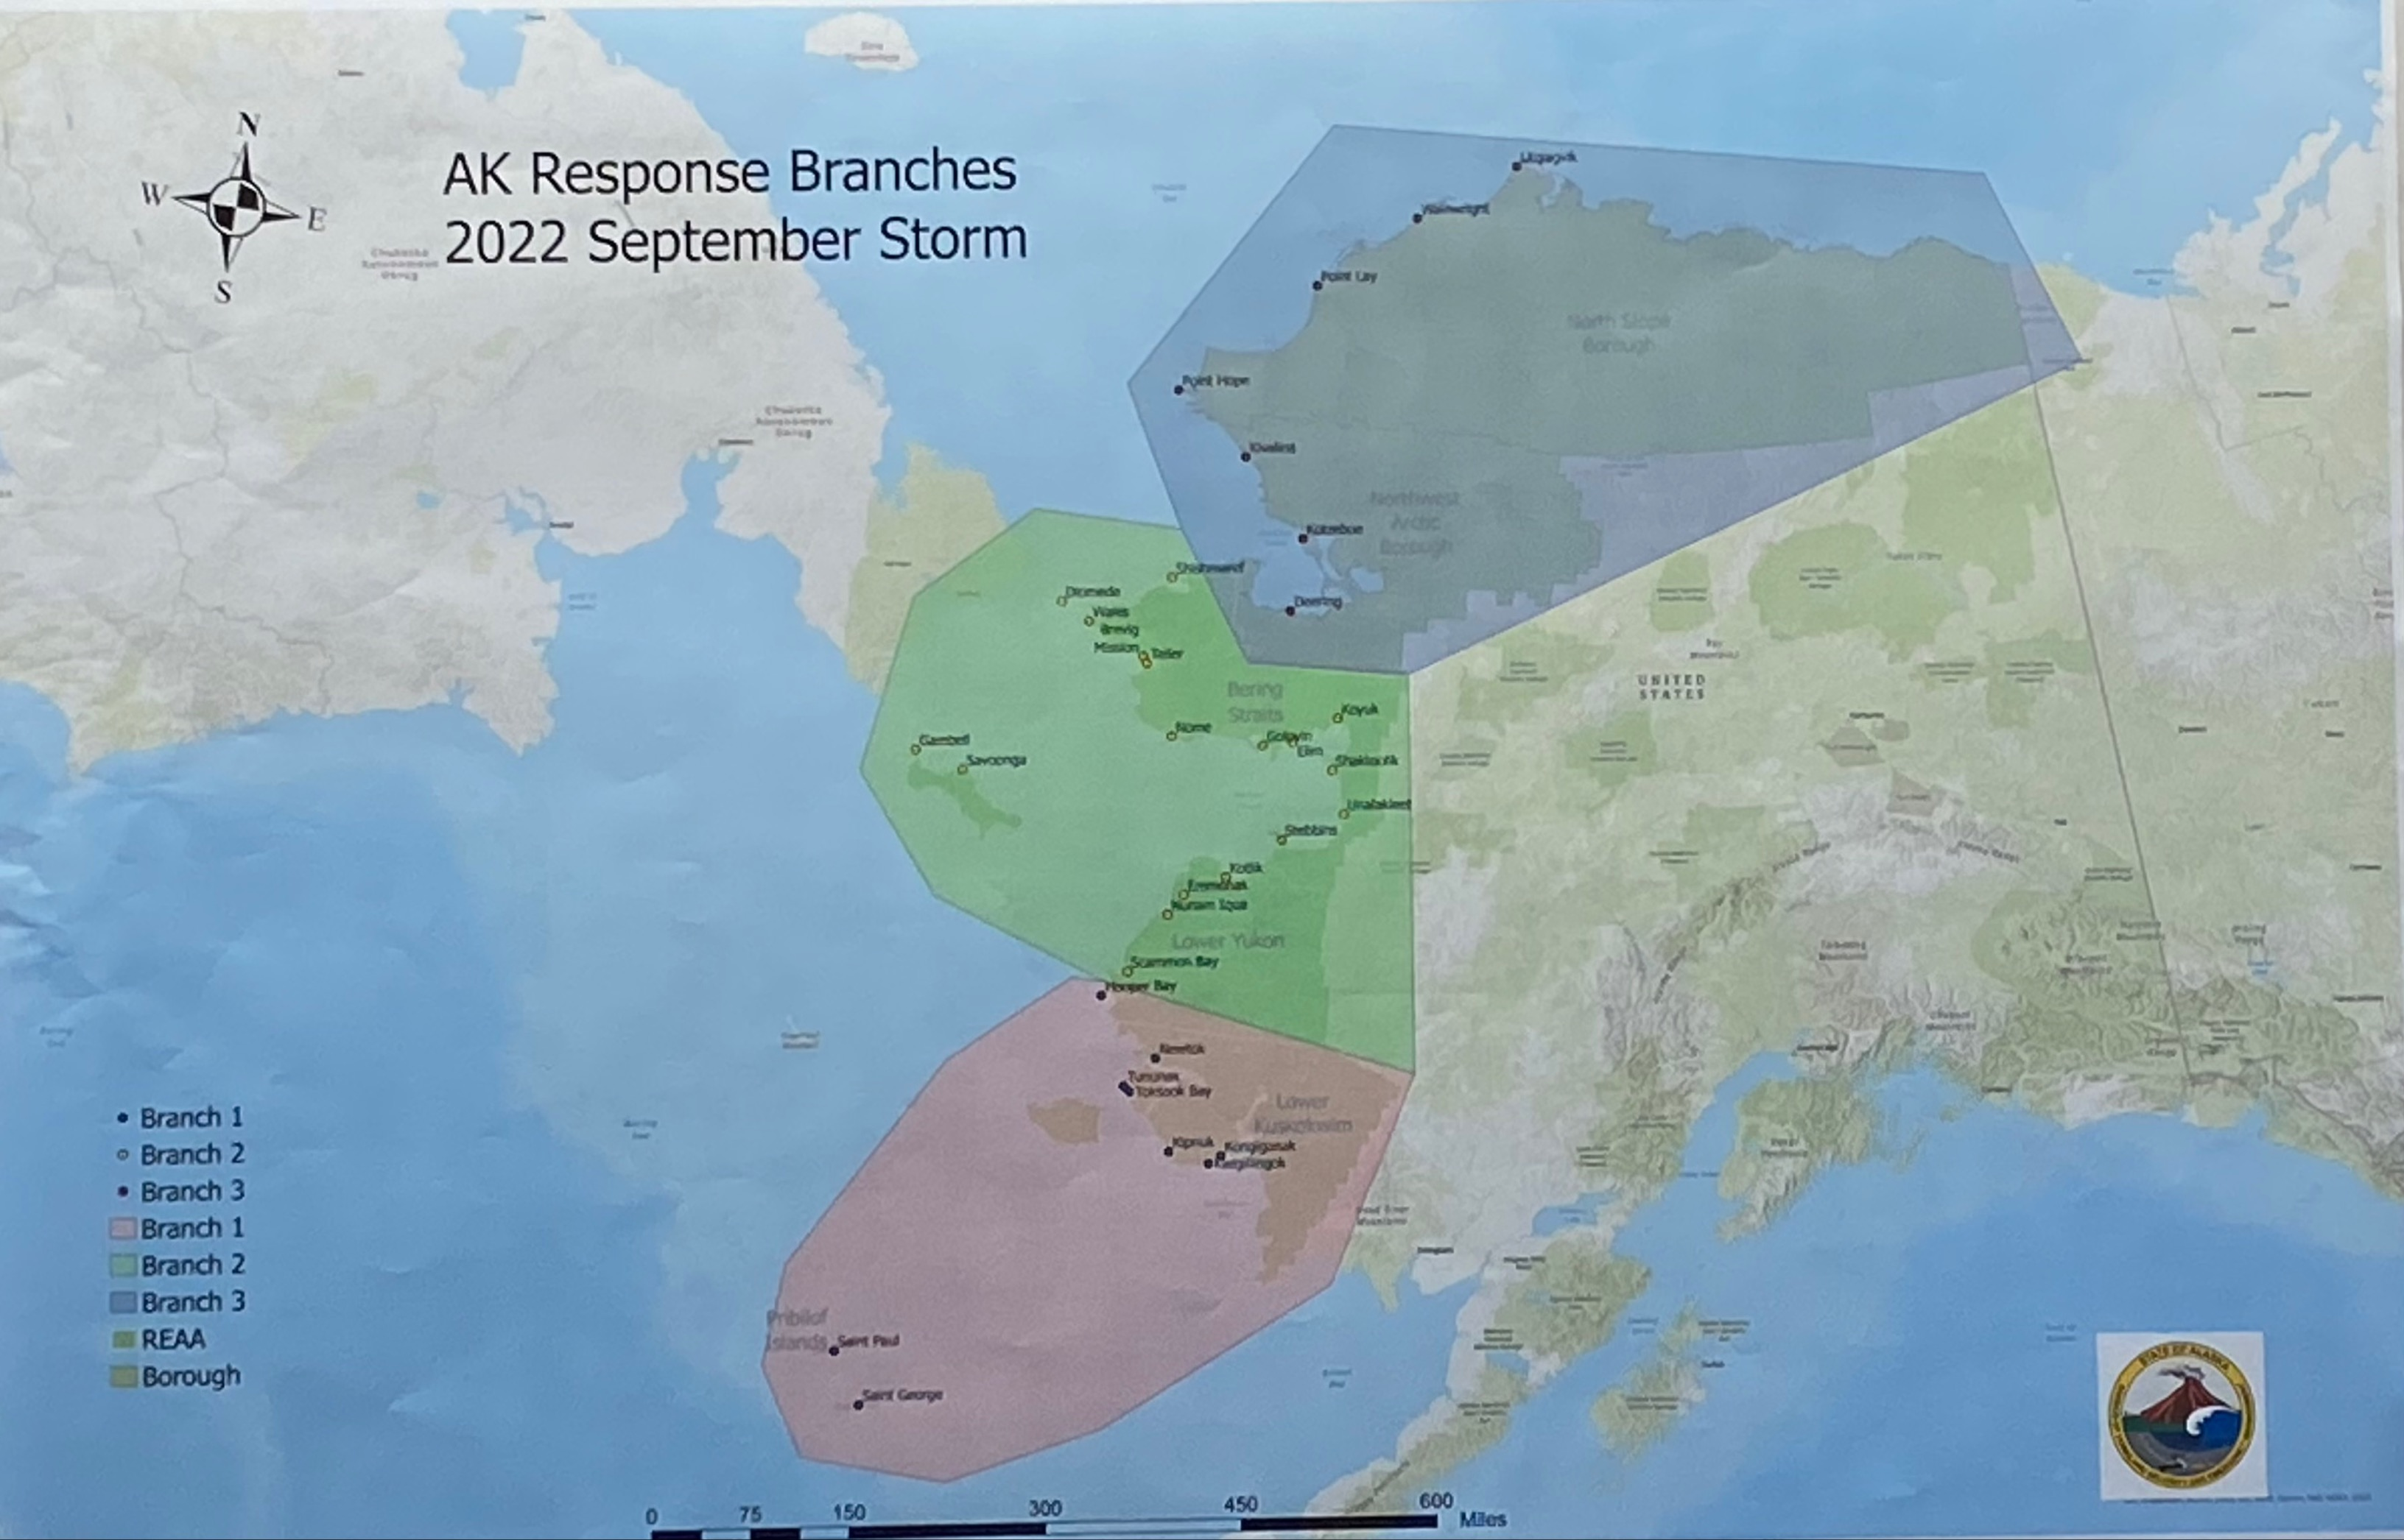
Branch Regions

Slide 27
Liaison Officer
Inter-Agency Reports

Slide 28
Logistics

Slide 29
Finance

Slide 30
Safety Officer

Slide 31
Public Information Officer

Slide 32
Meeting Schedule
Thursday, October 13, 2022 __ _____
Ops Brief 0800

Slide 33
Agency Administrator Remarks

Slide 34
IC Closing Remarks

